Slide 1
Are You at Risk for a Stroke?
The Answers May Surprise you...

Slide 2
Stroke Data Analysis
By: Matthew Harmon, Jessie Ju, Abby Schneider, Sean Stevens-Fabry

Slide 3
Stroke Risk
Strokes are a leading cause of death in the United States, with over 795,000 people in the US having one per year. Every 40 seconds someone in the US has a Stroke, and every 4 minutes someone dies from one. This project assesses risk factors associated with having a Stroke.

Slide 4
Data Source
Stroke Prediction Dataset - private dataset off of Kaggle, This dataset is used to predict whether a patient is likely to get stroke based on the input parameters like gender, age, various diseases, and smoking status. Each row in the data provides relevant information about the patient.
Framingham - The Framingham Heart Study is a long-term, ongoing cardiovascular cohort study of residents of the city of Framingham, Massachusetts. The study began in 1948 with 5,209 adult subjects from Framingham, and is now on its third generation of participants

Slide 5
Questions
Questions we hope to answer with data:
What are the leading risk factors for having a Stroke?
Can we use this data to accurately predict risk of someone having a stroke?
What other questions does this investigation raise?

Slide 6
Description
We used various descriptive statistics to examine the datasets.
We then used Supervised Machine Learning to create a predictive model to determine risk

Slide 7
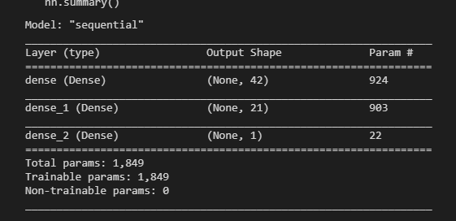
The Machine Learning Model
I chose to use Tensorflow Neural Network framework to build out the model of our data.
The reason for this was that it was what we just learned in the previous module before.
It was built using the sequential model with 2 hidden layers using the “relu” function and 1 output layer using “sigmoid”

Slide 8
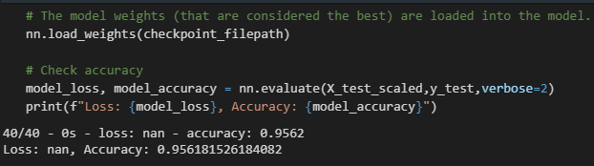
The Machine Learning Model
As we can see, the model that was built has an accuracy of 95.61%, which is fairly accurate. Of course, if you were predicted to be at risk of stroke using this model, see a professional for diagnosis.

Slide 9
Analysis
Description of the analysis phase of the project

Slide 10
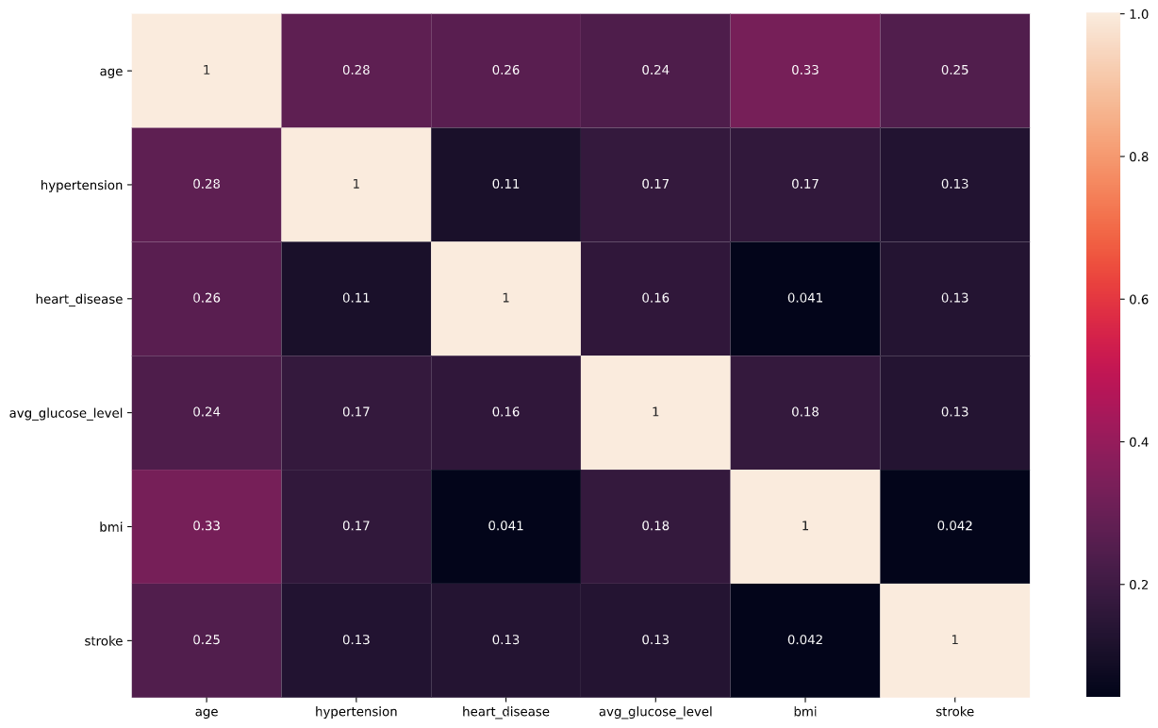
Analysis
A Correlation Matrix of Features

Slide 11
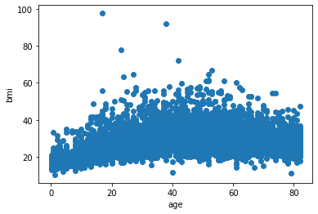
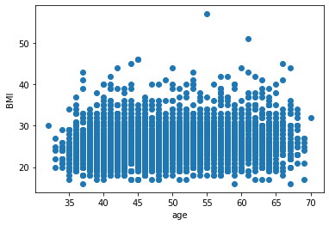
Age and BMI between datasets

Slide 12
xx%
Use this slide to show a major stat. It can help enforce the presentation’s main message or argument.

Slide 13

Final point
A one-line description of it

Slide 14
Stroke can be caused by multiple factors. Call 911 if you observe someone with symptoms of stroke.

Slide 15

Thanks for Listening!
Any Questions?

Slide 16
Citations
Centers for Disease Control and Prevention. (2021, March 17). Stroke Facts. Centers for Disease Control and Prevention. https://www.cdc.gov/stroke/facts.htm.
The Framingham Risk Score: An Appraisal of Its Benefits and Limitations
https://professional.diabetes.org/diapro/glucose_calc)
https://en.wikipedia.org/wiki/Framingham_Heart_Study#:~:text=The%20Framingham%20Heart%20Study%20is,its%20third%20generation%20of%20participants.

